Slide 1
SedLine Training Package

Slide 2
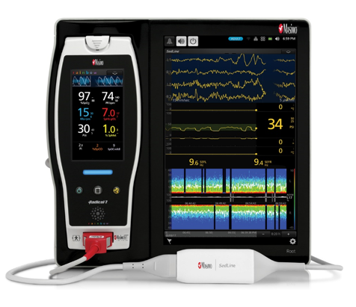

Next Generation SedLine
A training package developed by Technicians, for Technicians
This presentation is an introduction to SedLine
The objective is to reinforce knowledge following in-service training
It has been automated & annotated to allow self directed learning
Use the > key to move to the next slide
Use the < key to review the previous slide
Additional training links are available on completion

Slide 3
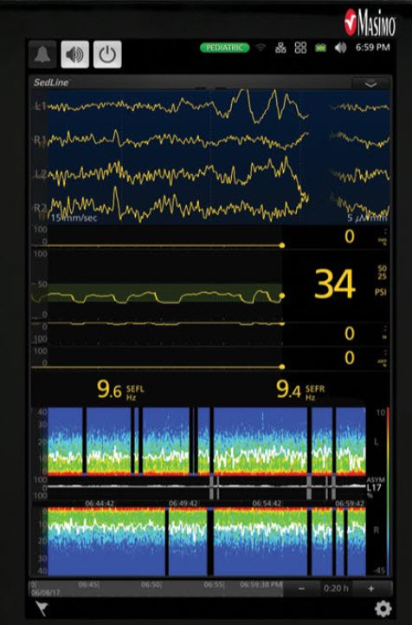
Next Generation SedLine
Four channels of diagnostic quality frontal EEG waveforms
Enhanced Patient State Index (Psi)
A processed EEG parameter related to the effect of anesthetic agents
A Density Spectral Array (DSA) contains left and right spectrograms representing the power on both sides of the brain

Slide 4
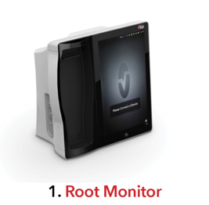
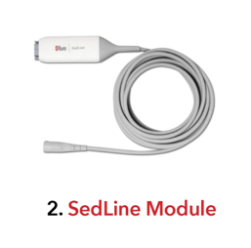
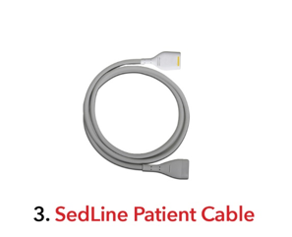
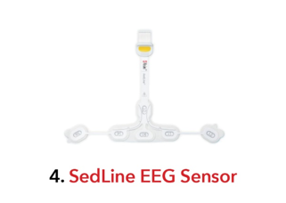

Components of the SedLine System

Slide 5
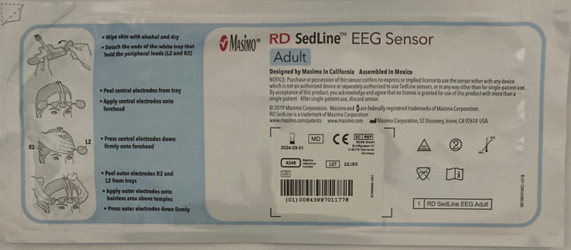
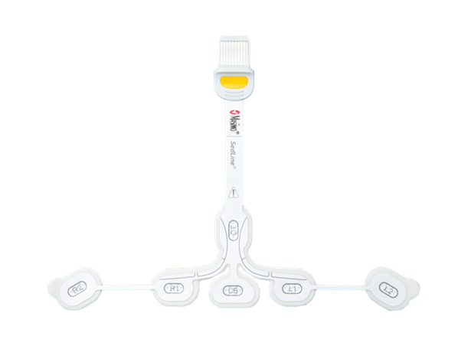
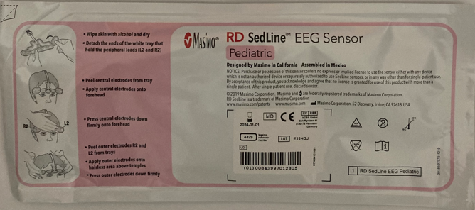
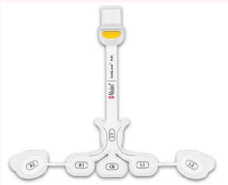
Sensors
Adult > 18 Years of age
Blue Packet
Pediatric > 1 – 18 Years of age
Pink Packet
When a pediatric sensor is connected to the patient cable, the SedLine module defaults to a pediatric algorithm for processing EEG, accounting for the higher frequency and amplitude of pediatric EEG

Slide 6
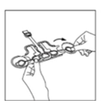
Preparation
Good skin preparation is key to the successful application and function of the SedLine sensor. Makeup, skin oils, and other debris on the application site will increase impedance and prevent good signal acquisition.
Wipe the skin with an Alcohol swab and allow to dry
Detach the ends of the tray that hold the peripheral leads (L2 and R2) by rotating gently prior to application to the forehead

Slide 7
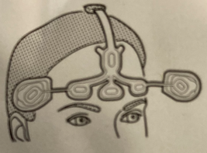
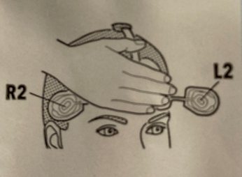

Sensor Application
Peel the central electrodes from the tray
Apply central electrodes onto the forehead
Press central electrodes firmly onto forehead
Peel outer electrodes L2 and R2 from the trays
Apply outer electrodes onto hairless area above temples
Press outer electrodes down firmly

Slide 8
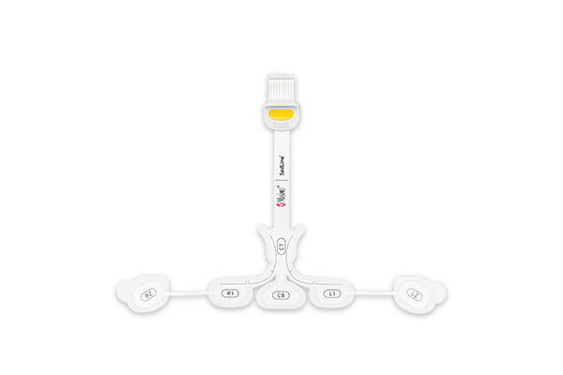

Sedline Electrodes
CT = Reference
Masimo Sedline uses 6 electrodes
1 Ground
1 Reference &
4 Monitoring
R2
R1
L1
L2
= Monitoring Electrodes
CB = Ground

Slide 9
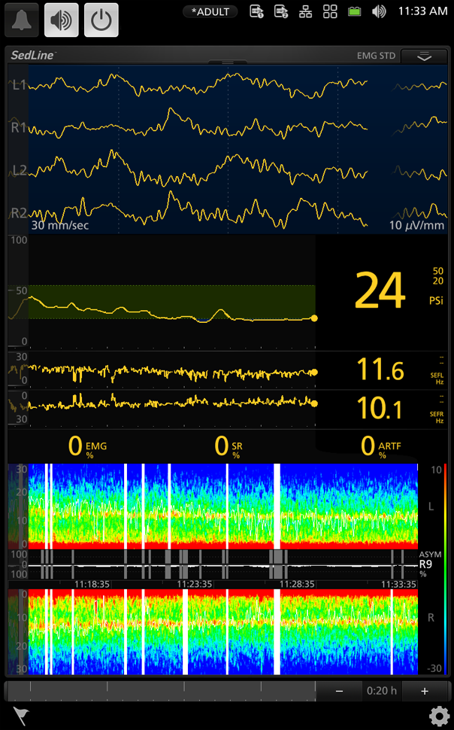
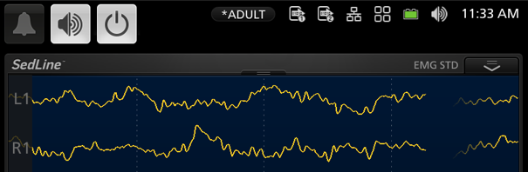
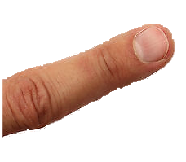

Electrode Performance
To check electrode performance, use the “Drop down menu tab” located above the Raw EEG and drag down
Tendencias
Notes:
En cuanto a la verificación de los electrodos, debemos localizar la pequeña muesca que se encuentra en la zona central, sobre el trazado de la curva electroencefalográfica.
Cuando encontramos la muesca colocamos sobre ella el dedo, contando 1…2… y deslizando el dedo hacia abajo.

Slide 10
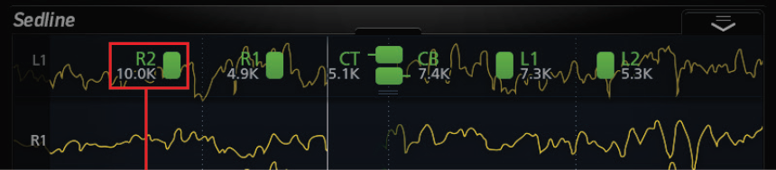
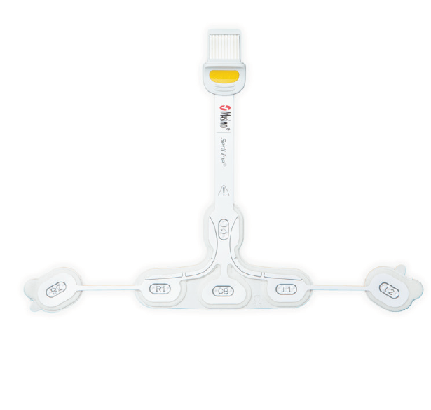
Electrode Performance
Electrode performance is:
Displayed as a color
(Green or Yellow is acceptable)
Measured in Ohms (Resistance)
The lower the resistance the better electrode performance

Slide 11
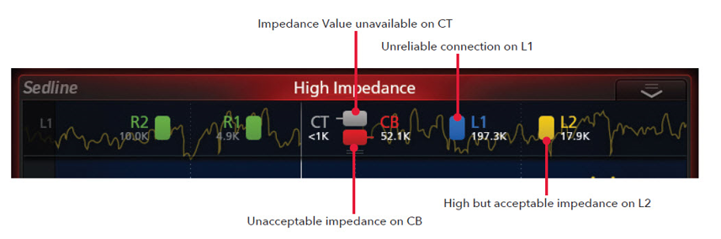
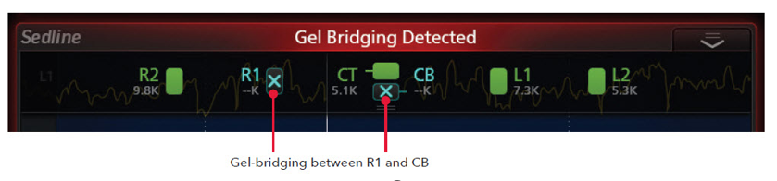
Electrode Performance
Examples of electrode status
Electrodes with an unreliable connection or high impedance should have gentle pressure applied to the edges of the electrode to improve connection (poor site preparation or hair are common causes of high resistance)
Gel bridging is usually caused by excessive pressure, forcing the conductive gel out of the electrode
and connecting to an adjacent electrode

Slide 12


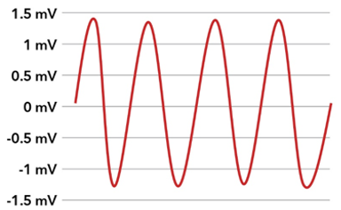
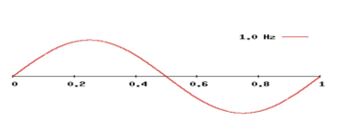
EEG Measurement
EEG is measured by analyzing two factors
Frequency is the number of times per second one complete cycle of a waveform occurs, measured either peak-to-peak or trough-to-trough
Amplitude is the measurement of the height of a wave and is displayed in micro-volts (mV)
Frequency is measured in Hertz (Hz)
cycles per second

Slide 13
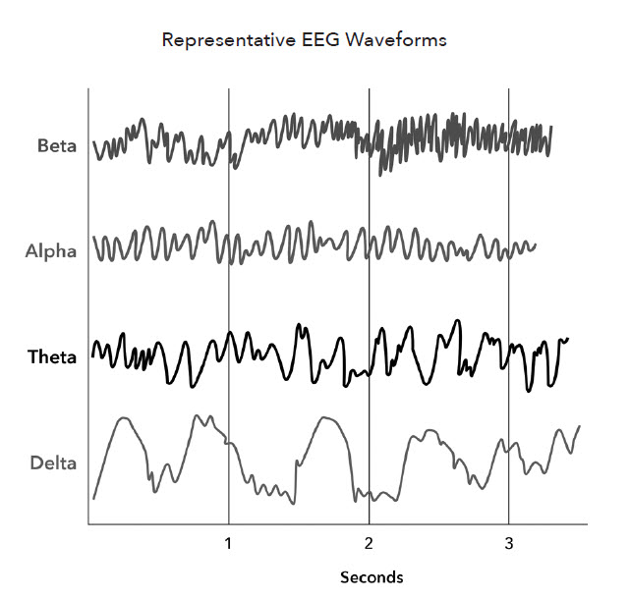
EEG
Electroencephalography
There are five EEG patterns present in the human brain. They are named after the letters of the Greek alphabet and arranged by frequency bands (number of cycles per second) or Hertz (Hz).
Gamma
30 – 100+ Hz
Beta
13 – 30 Hz
Gamma waves are associated with higher levels of consciousness, cognitive function, learning and memory
Alpha
8 – 12 Hz
Theta
4 – 8 Hz
SedLine is not a consciousness monitor, so it does not detect Gamma waves
Delta
1.0 – 4 Hz

Slide 14
EEG Recognition
As the EEG frequency (cycles per second) slows, anesthetic depth increases
Light
Deep

Slide 15
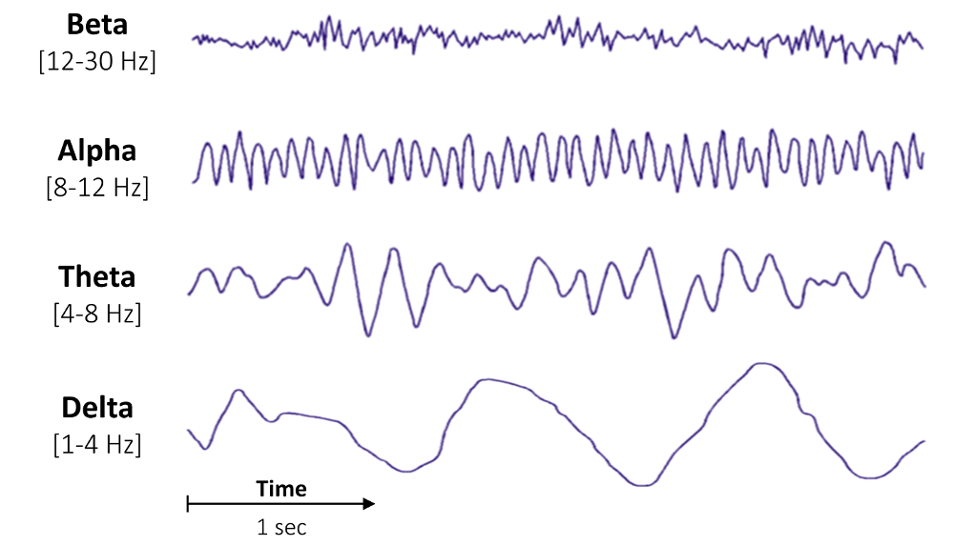
EEG Recognition

Slide 16
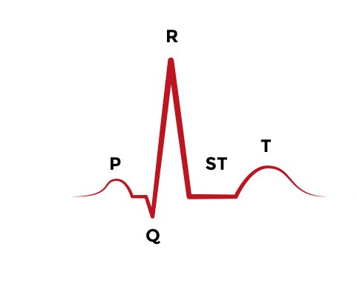
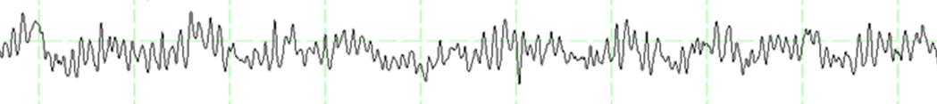
EEG Recognition
Unlike an ECG tracing which is ordered P, Q , R, S, T
EEG patterns occur at the same time. This EEG pattern is predominantly Alpha waves (8-12 cycles per second or Hz), these can be counted. The green lines are one second apart. Delta waves are always present. Can you see the Delta waves?

Slide 17
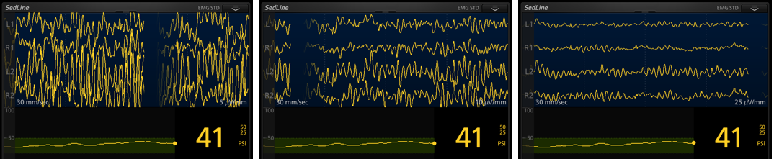
Adjusting EEG Amplitude
EEG can be scaled to help you identify the frequency of the waveform present. Increasing the mV scale will decrease the size of the waveform making it easier to see. Touch the mV scale to configure amplitude.
(this can be useful in children who have higher powered EEG).
High Amplitude
5 mV/mm
10 mV/mm
25 mV/mm
In the elderly brain (low power) you may need to scale the size of the EEG up so you can see the pattern. This can be done by decreasing the mV scale to 3, 2 or 1 mV/mm

Slide 18
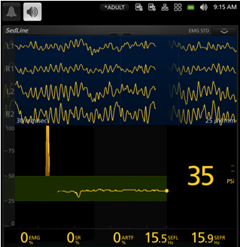
Spectral Edge Frequency
Spectral Edge Frequency displays the EEG (cycles per second) in Hz calculated from the Raw EEG every 1.2 seconds
You don’t have to count them!
SedLine is a Bi-Hemispherical sensor. Spectral Edge frequency is displayed for both sides of the brain
SEFL
Spectral Edge Frequency Left
SEFR
Spectral Edge Frequency Right
Spectral Edge Frequency is also displayed in the Density Spectral Array (DSA), this will be explained later.

Slide 19
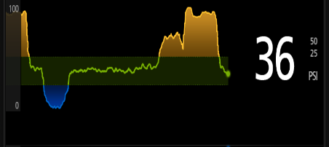
Patient State Index
(PSI)
PSI is a processed EEG parameter that is related to the effect of anesthetic agents
100
Light Hypnotic State
51
50
General Anaesthesia
25
24
Deep Hypnotic State
01
The PSI is displayed as a trend. Blue conveys a reading below the user configurable limit, yellow above and green within. The defaults are set at 25-50.
0
Complete EEG Suppression
Notes:
19
Resumiendo el PSI o índice de estado de paciente que reflejará el estado de conciencia del paciente, será :
entre 50 y 75 cuando el paciente está en estado hipnótico ligero
entre 25 y 50 cuando el paciente está dentro del rango optimo para anestesia general o sedación
entre 24 y 01 cuando el paciente se encuentra en estado hipnótico profundo
por debajo de 1, los períodos de supresión de la eeg son significativos
Si el número aparece en blanco, esto indica que, temporalmente, los datos adquiridos son insuficientes para calcular un valor PSI (probablemente, debido a artefactación)

Slide 20
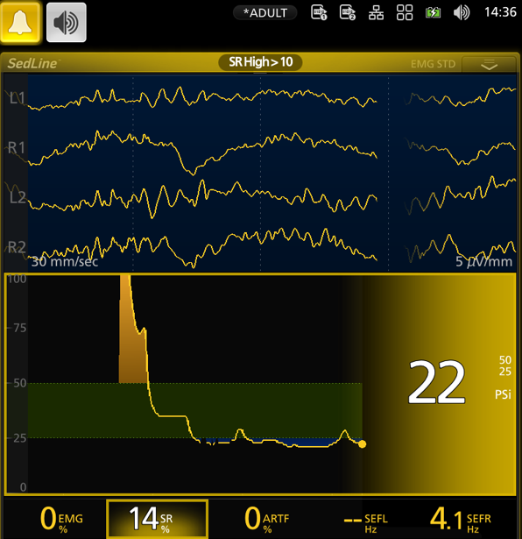
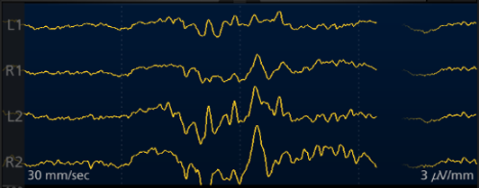
Suppression Ratio
(SR)
Suppression refers to an almost isoelectric EEG signal
Burst
Suppression
Burst Suppression is the term given to an EEG pattern that is
almost isoelectric with bursts of power
Suppression Ratio is displayed as the % of time the EEG has been suppressed during the last minute

Slide 21
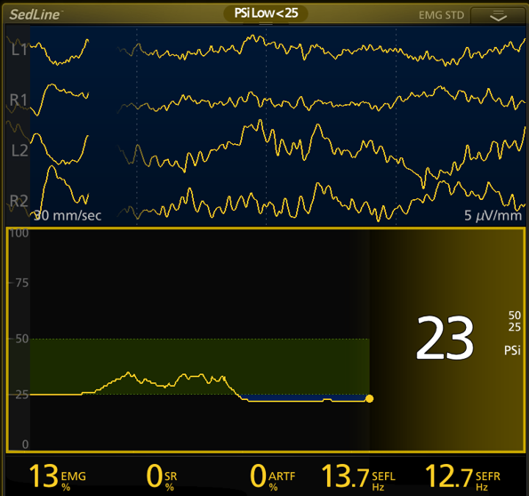
(EMG)
Electromyograph
EMG measures detected muscle activity, such as
eye opening, blinking, jaw clenching or grimacing.
EMG is displayed as a percentage

Slide 22
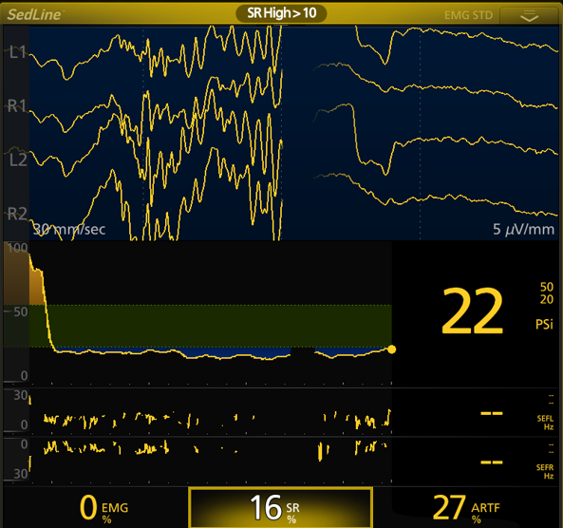
Artifact
(ARTF)
Artifact measures how much physiological (non brain related) and environmental noise the system detects.
ARTF is displayed as a percentage.
Artifact may be caused by:
Electrocautery
Forced air warming devices
Leakage current from a Surgical Stacks, etc.
Can you also see burst suppression in this EEG?
Low power EEG can make the Spectral Edge Frequency (SEFL & SEFR) unavailable. This is indicated by the two dashes where numbers should be.

Slide 23


What is the Patients Anaesthetic Depth?
Light or Deep?
Burst Suppression on EEG
PSI below configured limit
SEFL & SEFR unavailable due to low power EEG
16% of the last minute in suppression

Slide 24
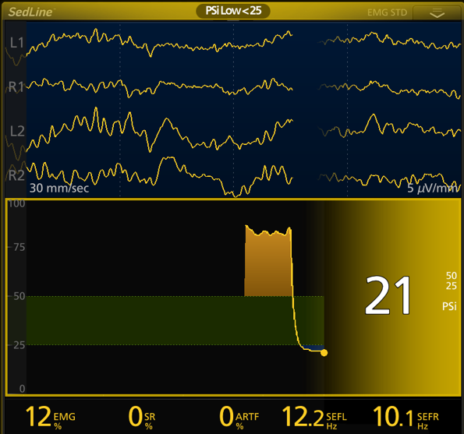
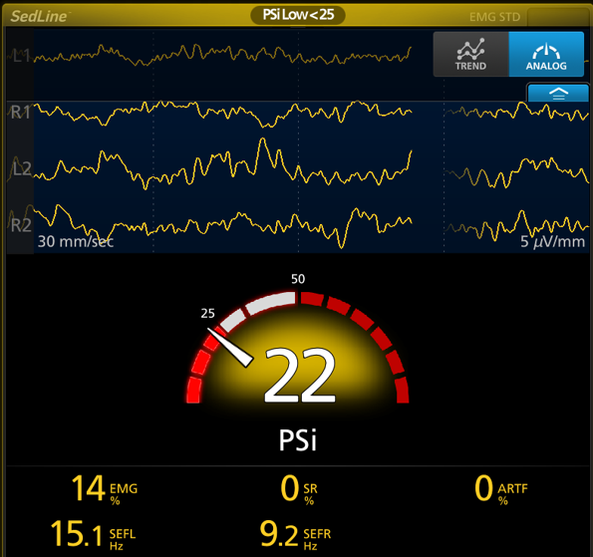
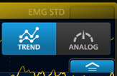
Display Options
The numerical display can be set to, Trend or Analog view
Use the drop-down menu to select Analog

Slide 25
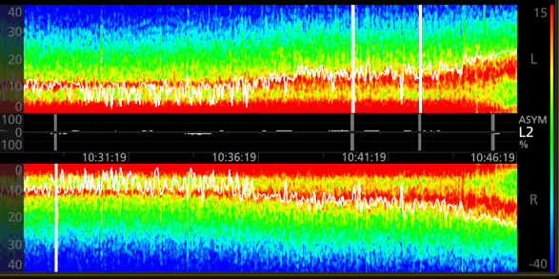
Density Spectral Array
DSA
The Density Spectral Array is a power frequency analysis over time (20 minutes).
It contains left and right spectrograms representing the power of both sides of the brain

Slide 26


















Density Spectral Array
EEG is analyzed to access the power of each waveform (a power frequency analysis).
The EEG waveform is analyzed by frequency bands
and graphed according to power
Delta
Theta
Alpha
Beta
Delta waves
Theta waves
Alpha waves
Beta waves
Power dB
Then colored according to power, the warmer the color the more power.
RED High Power
Yellow
0 Hz
4 Hz
8 Hz
12 Hz
Green
Blue Low Power
Frequency Hz

Slide 27






Density Spectral Array
The power frequency analysis is reoriented
Then repeated every 1.2 seconds to show power and frequency over time
Power dB
Frequency Hz
Time

Slide 28
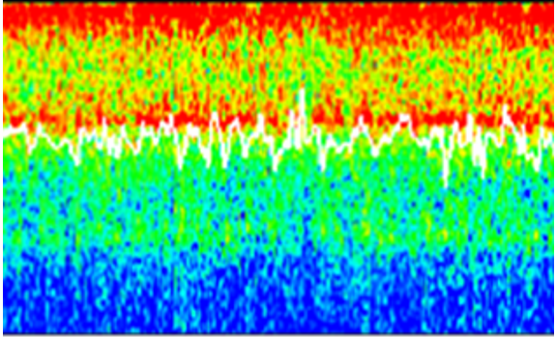
Density Spectral Array
As seen on the DSA
A power frequency analysis over time

Slide 29
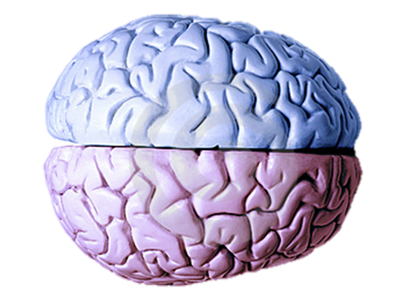


Density Spectral Array
Representing the power on both sides of the brain.
Frequency Bands
Beta 12 – 30Hz
Alpha 8-12Hz
Theta 4-8Hz
Delta 0-4Hz
Because Sedline monitors both sides of the brain, we can detect if one side has more power than the other (asymmetry). This is displayed as a white line in the center of the DSA and represented as a % of recent time on the right of the DSA.

Slide 30
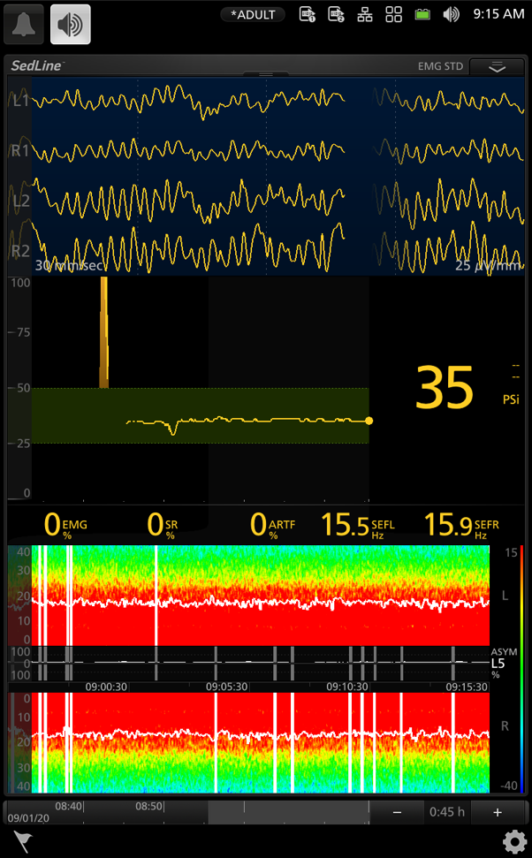
DSA & Spectral Edge Frequency
(SEF)
Spectral Edge Frequency
The frequency at which 95% of the EEG power exists.
Spectral Edge Frequency (SEFL & SEFR ) are plotted on the DSA as a white line, every 1.2 seconds.
The thickness of SEF the line can be adjusted by touching the DSA over the SEF line, +/- to select fine, medium or thick line.

Slide 31
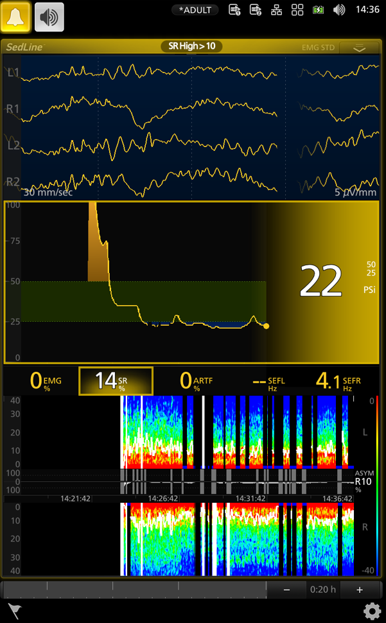
DSA & Suppression Ratio
(SR)
Suppression Ratio
Percentage of time the EEG has been almost isoelectric during the last minute
Seen in the DSA as a black line with a blue pixel

Slide 32
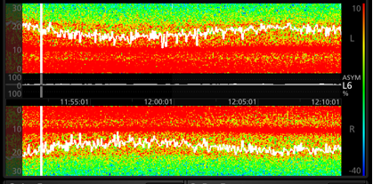
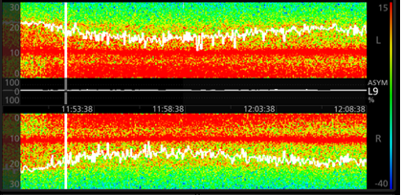
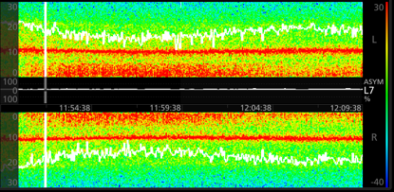
Adjusting DSA According to Power
Like the EEG, the DSA can be scaled so you can see more clearly the pattern.
To scale the DSA, touch the power scale measured in Db to make the colors in each frequency band easier to see. (+ -)
This DSA is from a young person. Their EEG power is high and therefore the colors are easy to see.
In the elderly patient you may need to scale the DSA in the opposite direction to see where the power is.

Slide 33
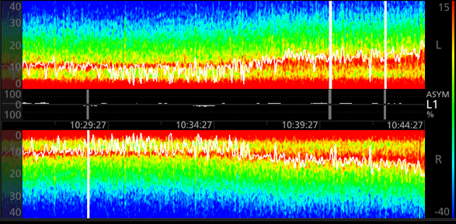
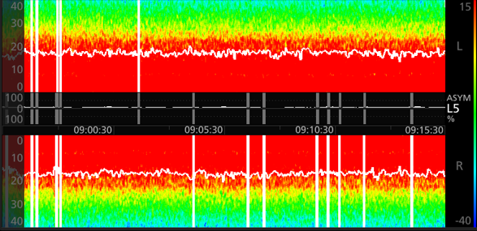
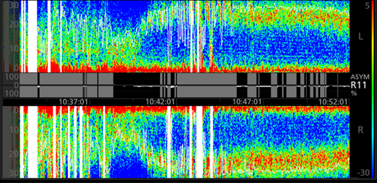
Drug Signatures
Anaesthetic agents have different effects on the brain; they create patterns that are easily recognizable in the DSA
TIVA Anaesthetic, Delta (0.5-4Hz) and Alpha (8-12Hz) are predominant. This DSA shows a lightening of Anaesthetic (an unzipping of the DSA).
Volatile Anaesthetic, predominance of Delta & Alpha with a filling effect of Theta waves.
Ketamine and N20 cause Beta waves (25-30Hz)

Slide 34
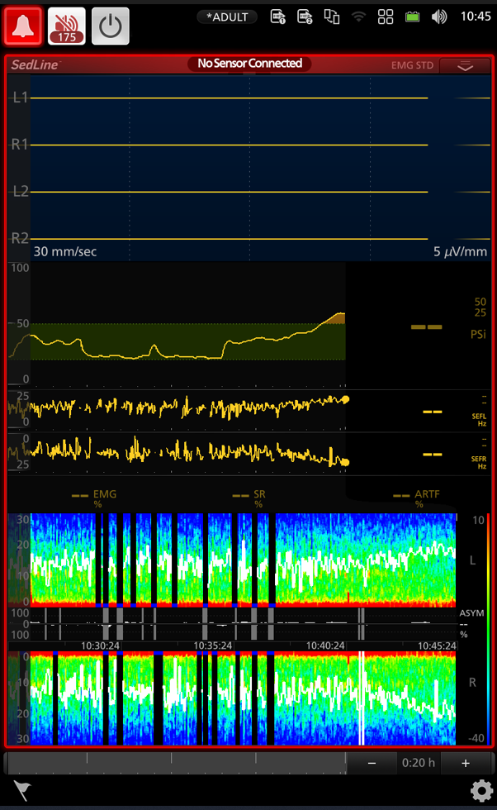
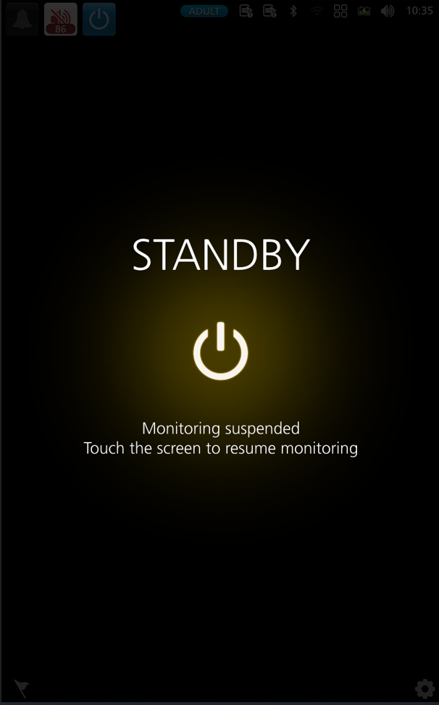

Standby
At the end of the case, once the sensor has been removed
Silence the alarm and touch the power icon
Confirm selection. The Root monitor will beep twice and enter the standby screen.
The Standby screen can also be used when transferring or positioning the patient, where disconnection of the patient cable from the sensor is required.

Slide 35








Trouble Shooting
Remember, good preparation: alcohol wipe, firm pressure.
Use the sensor check tab if you are not sure of your connection.
If you have an electrode connection problem and can not access the head, impedance monitoring can be turned off.
Touch the settings icon bottom right to access the menu.
Move toggle to the off position
Confirm selection
Select
Select

Slide 36
Monitor Impedance
Trouble Shooting
When monitor impedance is turned off the drop-down sensor check is no longer available
When monitor impedance is turned off all values and the DSA will be displayed irrespective of connection quality
It is important to remember when monitor impedance is turned off, high resistance in electrodes may cause variations in the Spectral Edge Frequency, Patient State Index and the Density Spectral Array
Remember to turn the monitor impedance back on for the next case
If the sensor check is not available this will have been turned off by a previous user. Access Sedline from the settings icon, select additional settings and turn impedance on

Slide 37






Testing
The Sedline test tool can be used to check the integrity of the module and patient cable.
Connect the module and patient cable to one of the MOC 9 ports on the Root monitor
Connect the test tool to the patient cable
Use the sensor check tab to measure resistance (the EEG should be isoelectric)
Reduce the microvolts to 1mV/mm
Observe low resistance, 4.5 & 5.5K Ohms & 2mm
peak-to-peak noise in the EEG.

Slide 38

Sedline Test Tool
Testing
All green with 2mm peak-to-peak noise is a pass
This is a failed test, to isolate the fault (patient cable or module).
You will need to test components against a known passed module and patient cable.

Slide 39
Terminology
Sedline
EEG Electrocochleography
PSI Patient State Index
SEFR Spectral Edge Frequency Right
SEFL Spectral Edge Frequency Left
EMG Electromyography
ARTF Artifact
DSA Density Spectral Array
Measurement
Ohms Resistance (Electrode performance)
Hz Hertz (Spectral Edge Frequency)
dB Decibel (DSA color scale)

Slide 40


Further Education Links
Look for this QR code on your Root monitor or scan me now.
https://purdonlab.mgh.harvard.edu/clinical-education/
Masimo - Clinical Evidence - SedLine Brain Function Monitoring

